Slide 1
Efficient Algorithms
Ekkapot Charoenwanit
Software Systems Engineering
TGGS
KMUTNB

Slide 2
Lecture 7: Dynamic Programming

Slide 3

Fibonacci Numbers
Fibonacci numbers can be defined as a recurrence as follows:
$$F_{0}=0$$
$$F_{1}=1$$
$F_{n}=F_{n−1}+F_{n−2}$ for $n≥2$

Slide 4
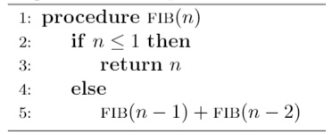
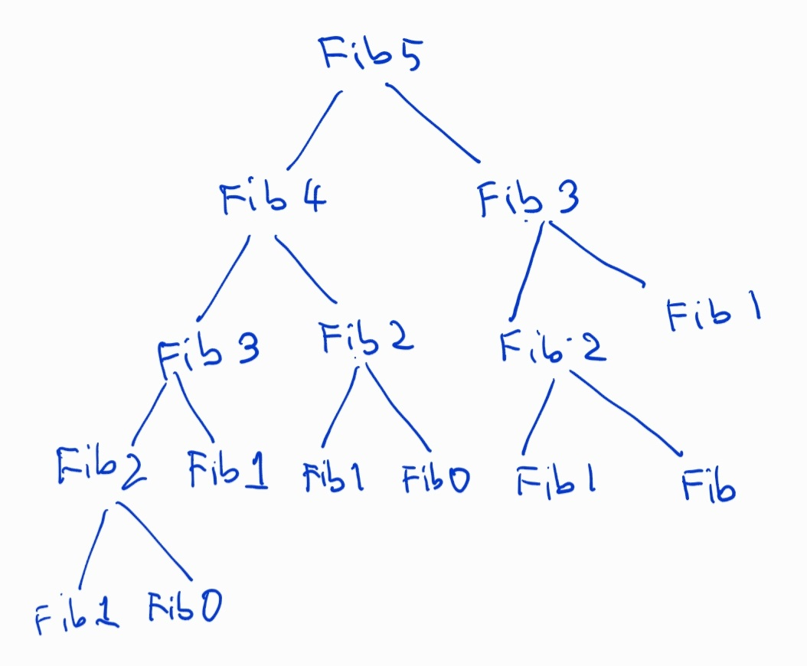
Fibonacci Numbers: Top-Down Approach
Top-Down Approach:
implemented via recursion

Slide 5

Fibonacci Numbers: Top-Down Approach
Let $N\left(n\right)$ be the number of recursive calls $FIB(n)$ makes.
We can write $N\left(n\right)$ as
$N\left(n\right)=N\left(n−1\right)+N\left(n−2\right)+1$ for $n≥2$
$N\left(0\right)=1$ and $N\left(1\right)=1$
Solving the recurrence, we have
$N\left(n\right)=2F\left(n+1\right)−1$ (By induction)
,where $F\left(n\right)=\frac{φ^{n}−{\left(1−φ\right)}^{n}}{\sqrt{5}}$ ,where $φ=\frac{1+\sqrt{5}}{2}≈1.61803$

Slide 6
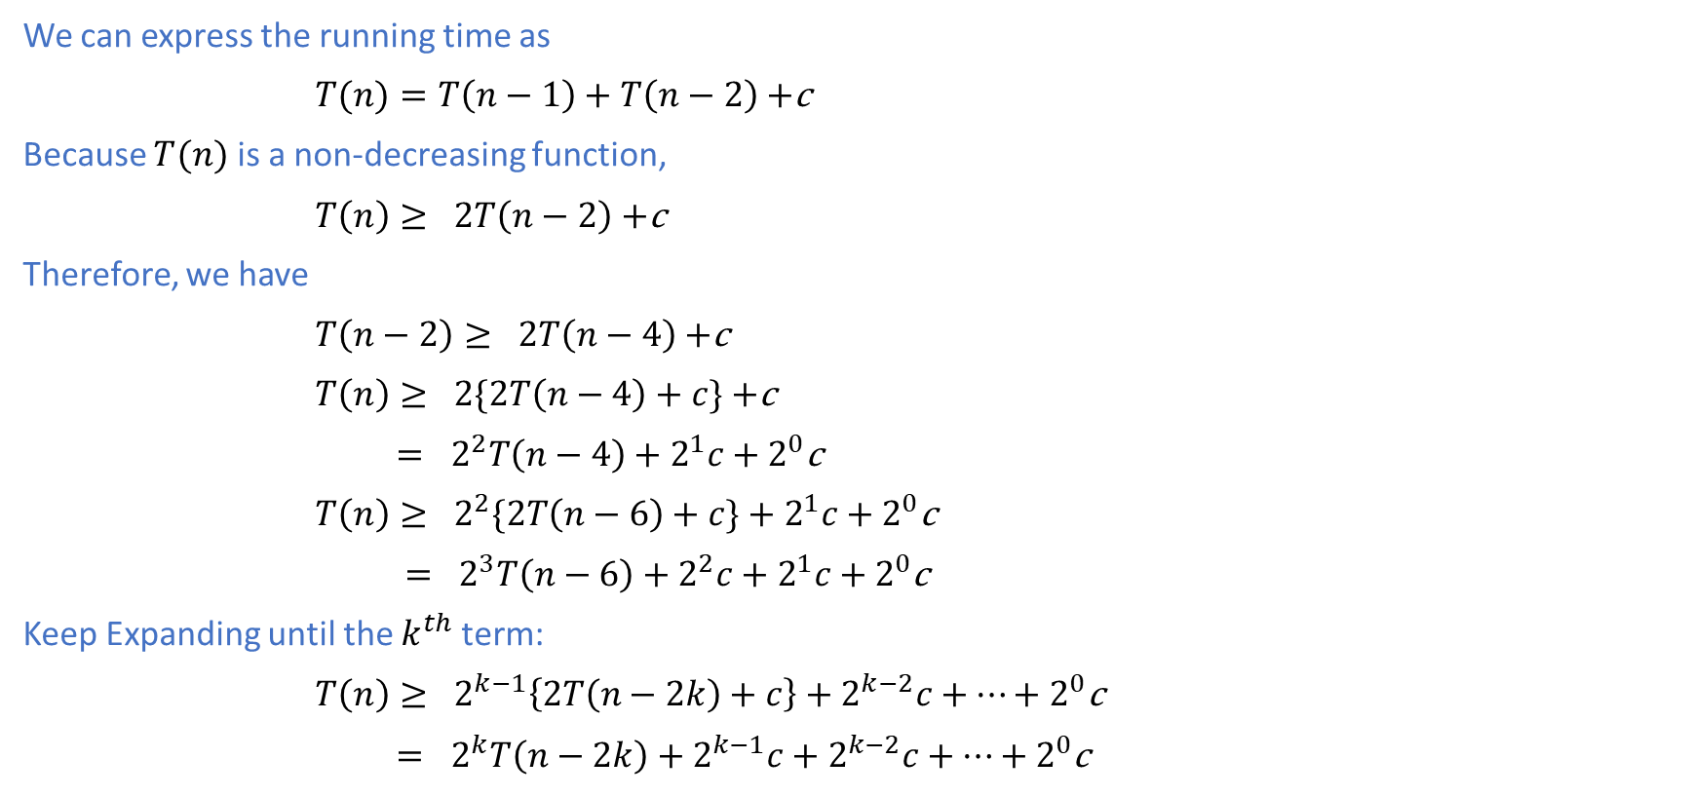
Fibonacci Numbers: Top-Down Approach
We can express the running time as
$T(n)=T\left(n−1\right)+T\left(n−2\right)+$c
Because $T(n)$ is a non-decreasing function,
$T\left(n\right)≥ 2T\left(n−2\right)+$c
Therefore, we have
$T\left(n−2\right)≥ 2T\left(n−4\right)+$c
$T\left(n\right)≥ 2\{2T\left(n−4\right)+c\}+$c
$= 2^{2}T\left(n−4\right)+2^{1}c+2^{0}$c
$T\left(n\right)≥ 2^{2}\{2T\left(n−6\right)+c\}+2^{1}c+2^{0}$c
$= 2^{3}T\left(n−6\right)+2^{2}c+2^{1}c+2^{0}$c
Keep Expanding until the $k^{th}$ term:
$T\left(n\right)≥ 2^{k−1}\left\{2T\left(n−2k\right)+c\right\}+2^{k−2}c+…+2^{0}\text{c}$
$= 2^{k}T\left(n−2k\right)+2^{k−1}c+2^{k−2}c+…+2^{0}$c

Slide 7

Fibonacci Numbers: Top-Down Approach
Recursion terminates when $n−2k=0$.
Therefore, $n=2k$ or $k=\frac{n}{2}$.
$$T\left(n\right)≥ 2^{k}T(0)+2^{k−1}c+…+2^{0}\text{c}$$
$= 2^{k}c+ 2^{k−1}c+…+2^{0}\text{c}$
$= c\frac{2^{0}(2^{k+1}−1)}{2−1}=c\left({2⋅2}^{n/2}−1\right)=c(2⋅{\sqrt{2}}^{n}−1)$
Therefore,
$T\left(n\right) ∈ Ω({\sqrt{2}}^{n})$
This proves that the running time of the top-down approach is at least exponential in the value of $n$. $∎$
Space complexity is proportional to the depth of the recursion tree, i.e., $Θ\left(n\right)$. $∎$

Slide 8
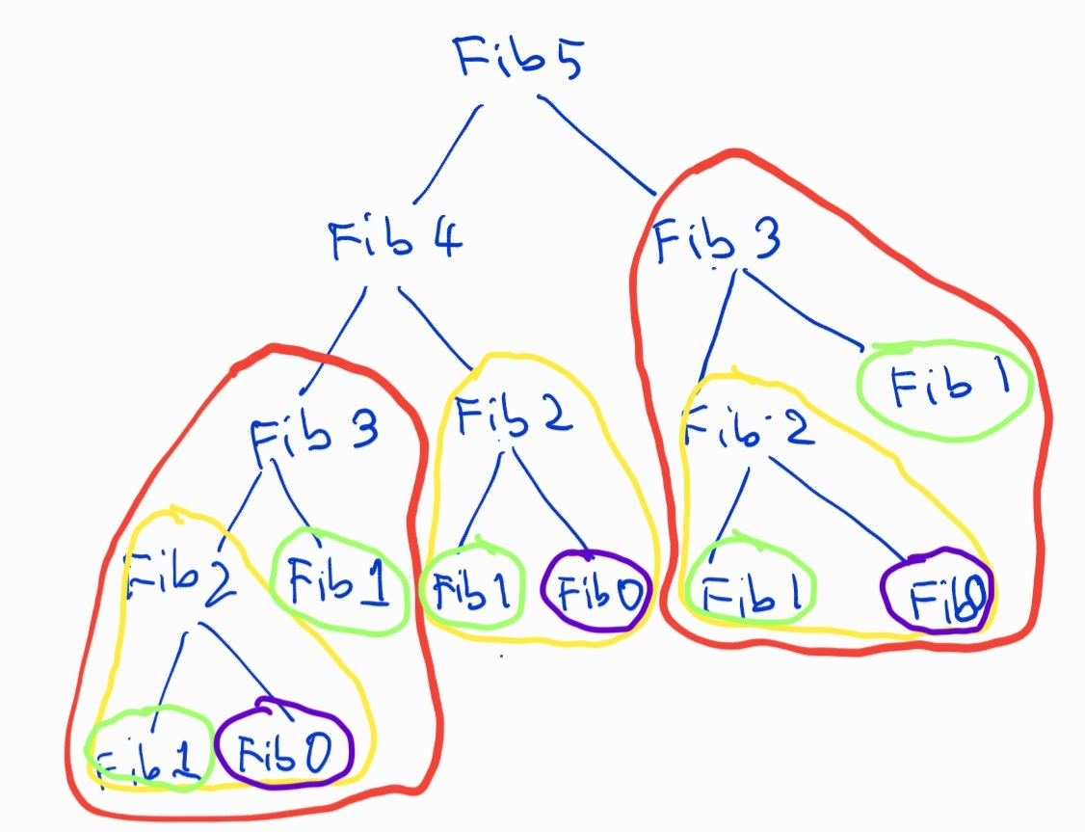


Fibonacci Numbers: Overlapping Subproblems
The recursion tree of $FIB(n)$ exhibits a property known as overlapping subproblems.
As you can see in the recursion tree for $FIB(5)$,
$FIB\left(0\right)$ is called 3 times
$FIB\left(1\right)$ is called 5 times
$FIB(2)$ is called 3 times
$FIB(3)$ is called 2 times
$FIB\left(4\right)$ is called 1 time

Slide 9
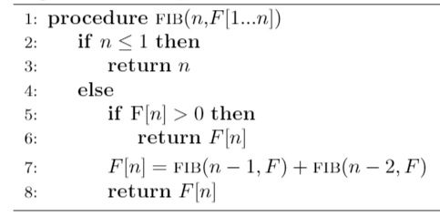

Fibonacci Numbers: Memoization
Memoization means “to remember” by storing values into a table.
All the entries of the table F are initially initialized to 0.
The number of different subproblems is $n+1$, namely, $FIB\left(0\right),FIB\left(1\right),FIB\left(2\right),…,FIB(n)$.
The number of recursive calls (non-memoized) is $Θ\left(n\right)$.

Slide 10
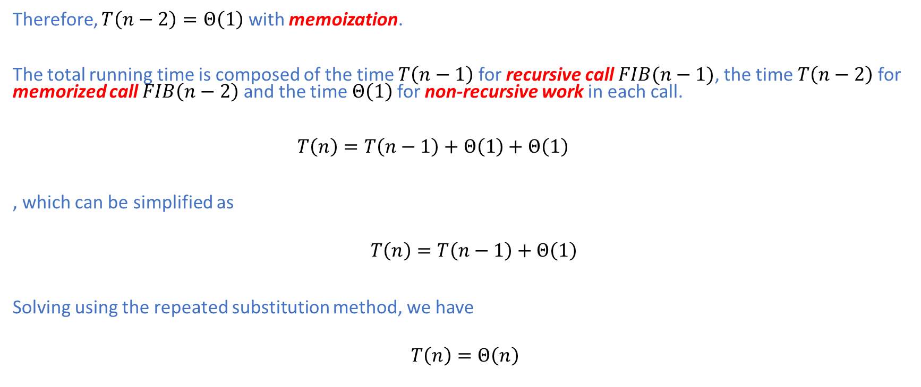
Fibonacci Numbers: Memoization
Therefore, $T\left(n−2\right)=Θ\left(1\right)$ with memoization.
The total running time is composed of the time $T\left(n−1\right)$ for recursive call $FIB(n−1)$, the time $T\left(n−2\right)$ for memorized call $FIB\left(n−2\right)$ and the time $Θ\left(1\right)$for non-recursive work in each call.
$T\left(n\right)=T\left(n−1\right)+Θ\left(1\right)+Θ\left(1\right)$
, which can be simplified as
$$T\left(n\right)=T\left(n−1\right)+Θ\left(1\right)$$
Solving using the repeated substitution method, we have
$$T\left(n\right)=Θ\left(n\right)$$

Slide 11
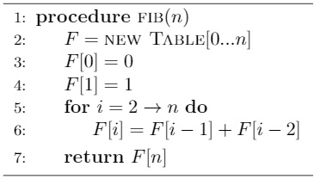
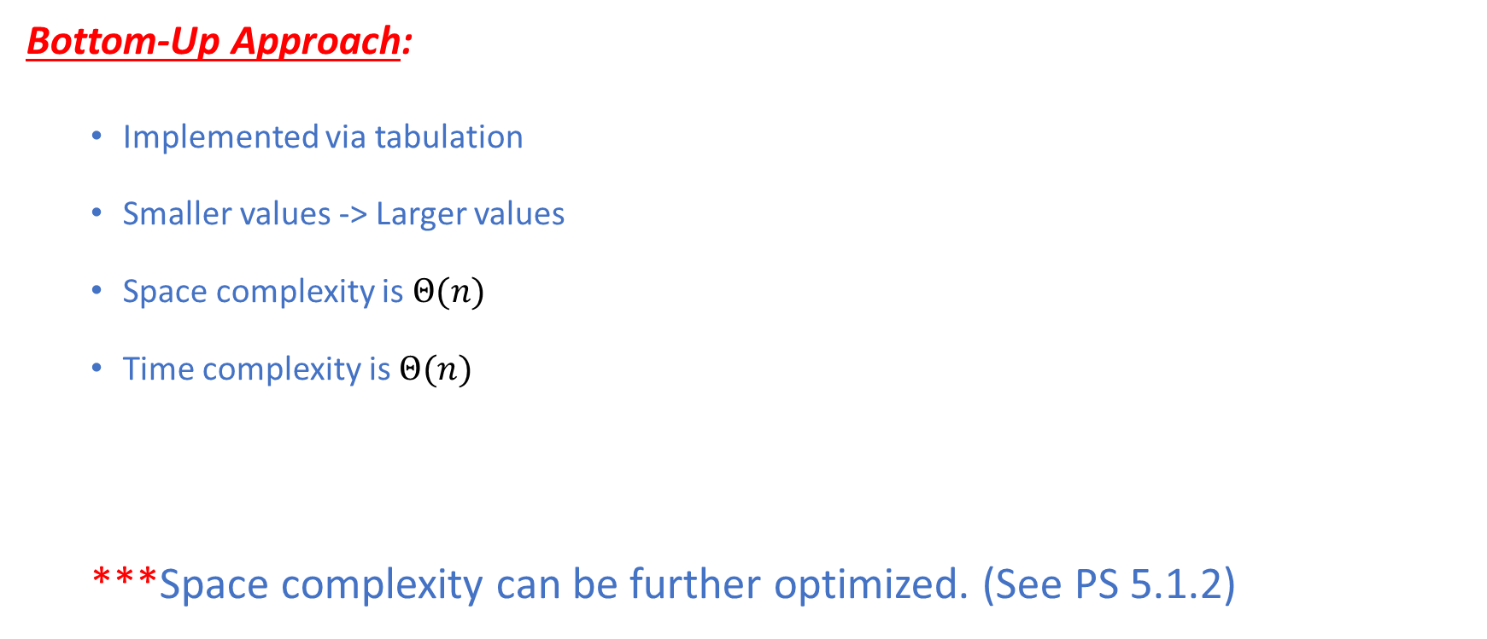
Fibonacci Numbers: Bottom-Up Approach
Bottom-Up Approach:
Implemented via tabulation
Smaller values -> Larger values
Space complexity is $Θ(n)$
Time complexity is $Θ(n)$
***Space complexity can be further optimized. (See PS 5.1.2)

Slide 12
Top-Down vs Bottom-Up
Top-Down Approach:
Recursion
Divides a problem into smaller subproblems
Solves the subproblems recursively
Avoid solving repeated subproblems via memoization
Bottom-Up Approach:
Loop Iterations
Solves smaller subproblems first
Generates optimal solutions to larger subproblems from optimal solutions to smaller ones
Solves each distinct subproblem only once and reuse these solutions

Slide 13
Dynamic Programming
Dynamic programming (DP) is a design paradigm where a computational problem is solved recursively
by solving smaller subproblems as in divide-and-conquer.
However, DP exploits the following two properties inherent in the problem:
Overlapping Subproblems
Subproblems solving the same problems are repeated many times
Solve such repeated subproblems only once and reuse their solutions via
Memoization (top-down)
Tabulation (bottom-up)
Optimal Substructure
An optimal solution to a problem contains optimal solutions to smaller subproblems
DP is usually used to solve optimization problems as we will see shortly.
Minimization
Maximization

Slide 14
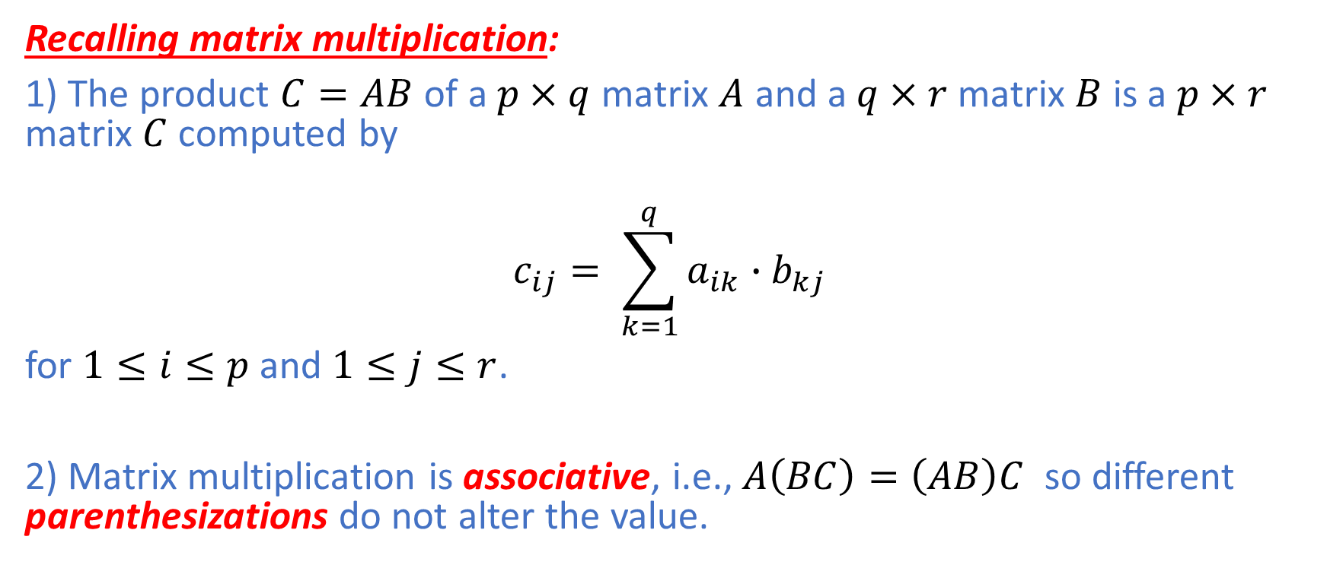
Matrix Chain Multiplication (MCM)
Recalling matrix multiplication:
1) The product $C=AB$ of a $p×q$ matrix $A$ and a $q×r$ matrix $B$ is a $p×r$ matrix $C$ computed by
$$c_{ij}= \sum_{k=1}^{q}{a_{ik}∙b_{kj}}$$
for $1≤i≤p$ and $1≤j≤r$.
2) Matrix multiplication is associative, i.e., $A\left(BC\right)=\left(AB\right)C$ so different parenthesizations do not alter the value.

Slide 15

Matrix Chain Multiplication
$$C = A × B$$
$\left[p ×r\right]$ $\left[p ×q\right]$ $\left[q ×r\right]$
To multiply $A$ and $B$,
$pqr$ multiplications are needed.

Slide 16
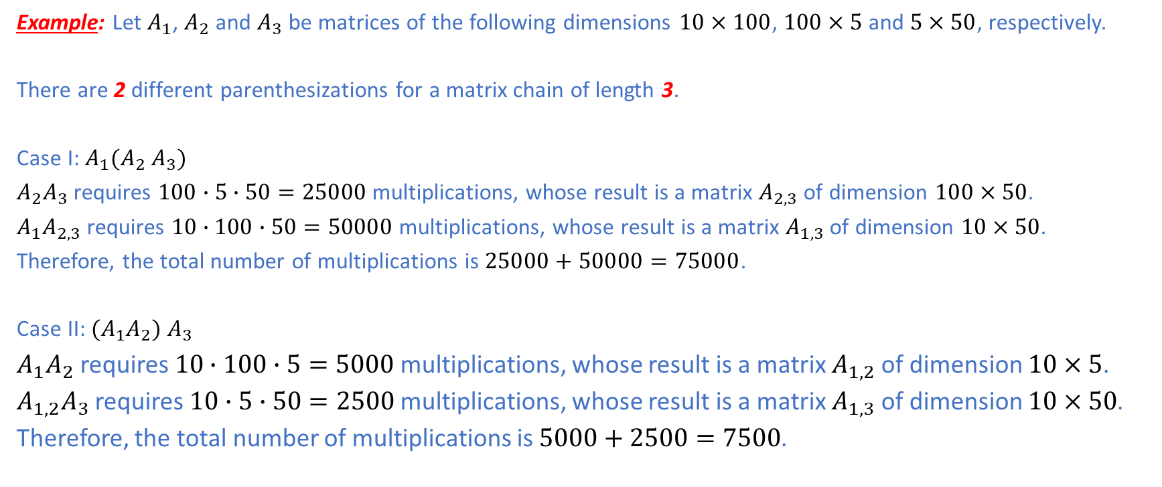
Matrix Chain Multiplication: Example
Example: Let $A_{1}$, $A_{2}$ and $A_{3}$ be matrices of the following dimensions $10×100$, $100×5$ and $5×50$, respectively.
There are 2 different parenthesizations for a matrix chain of length 3.
Case I: $A_{1}{(A}_{2}$ $A_{3})$
$A_{2}A_{3}$ requires $100∙5∙50=25000$ multiplications, whose result is a matrix $A_{2,3}$ of dimension $100×50$.
$A_{1}A_{2,3}$ requires $10∙100∙50=50000$ multiplications, whose result is a matrix $A_{1,3}$ of dimension $10×50$.
Therefore, the total number of multiplications is $25000+50000=75000$.
Case II: ${(A}_{1}A_{2})$ $A_{3}$
$A_{1}A_{2}$ requires $10∙100∙5=5000$ multiplications, whose result is a matrix $A_{1,2}$ of dimension $10×5$.
$A_{1,2}A_{3}$ requires $10∙5∙50=2500$ multiplications, whose result is a matrix $A_{1,3}$ of dimension $10×50$.
Therefore, the total number of multiplications is $5000+2500=7500$.

Slide 17
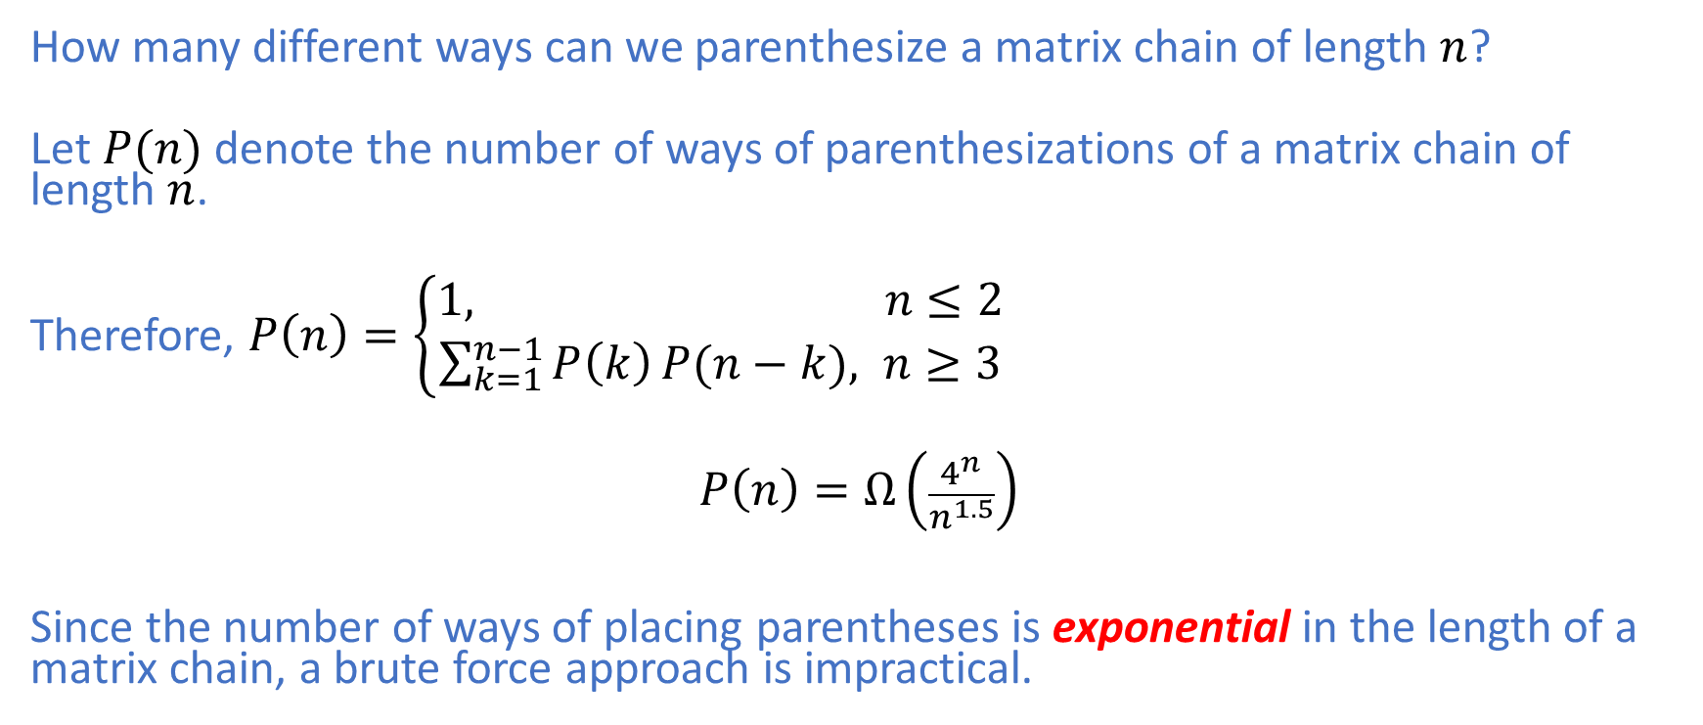
Matrix Chain Multiplication: Brute Force
How many different ways can we parenthesize a matrix chain of length $n$?
Let $P(n)$ denote the number of ways of parenthesizations of a matrix chain of length $n$.
Therefore, $P\left(n\right)=\left\{\begin{aligned}1, n≤2 \\ &\sum_{k=1}^{n−1}{P\left(k\right)}P(n−k), n≥3\end{aligned}\right.$
$$P\left(n\right)=Ω\left(\frac{4^{n}}{n^{1.5}}\right)$$
Since the number of ways of placing parentheses is exponential in the length of a matrix chain, a brute force approach is impractical.

Slide 18
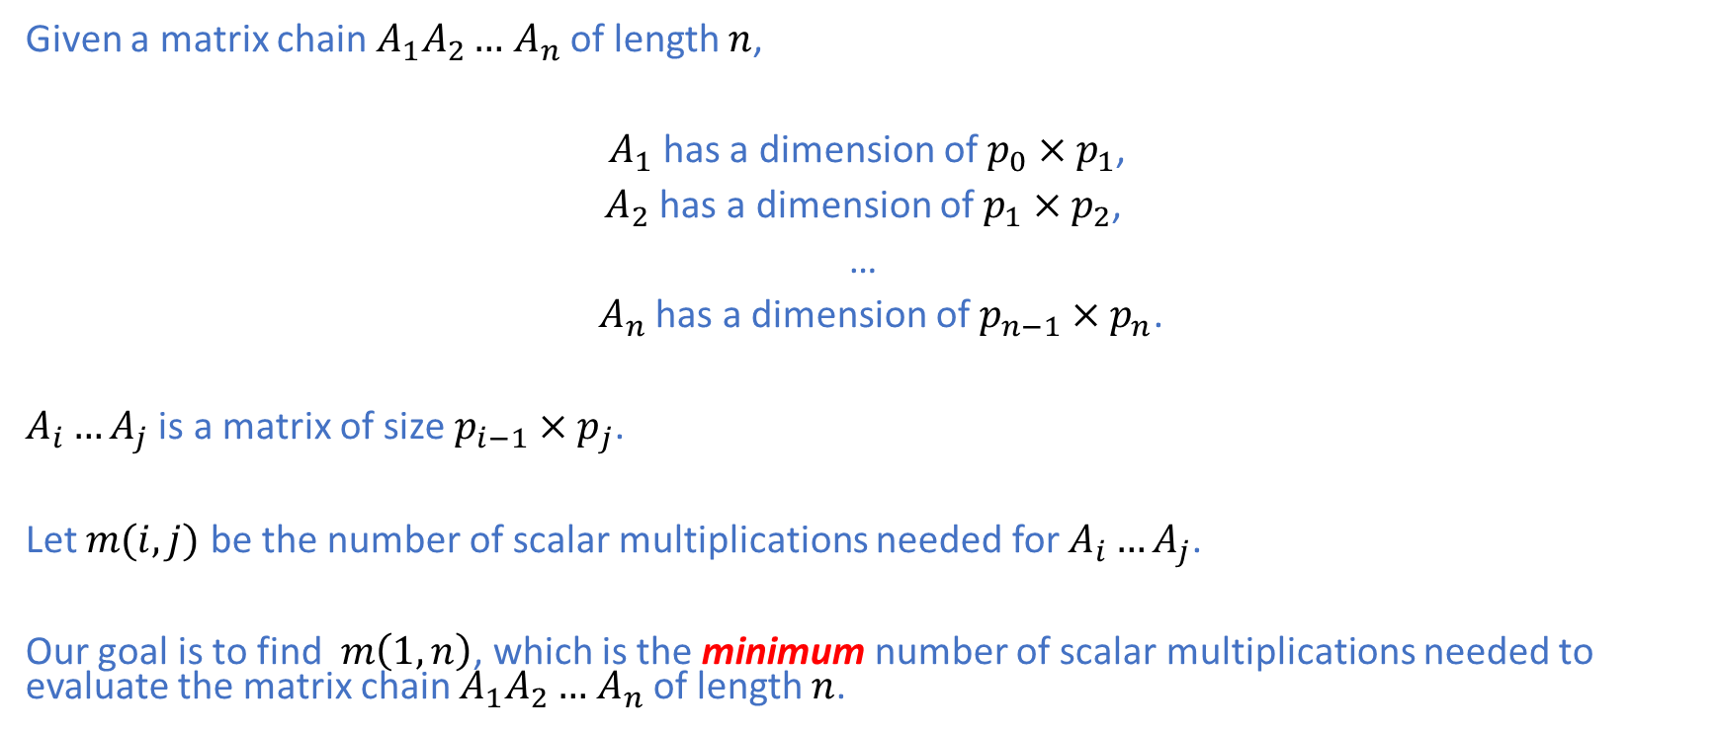
Matrix Chain Multiplication: Notation
Given a matrix chain $A_{1}A_{2}…$ $A_{n}$ of length $n$,
$A_{1}$ has a dimension of $p_{0}×p_{1}$,
$A_{2}$ has a dimension of $p_{1}×p_{2}$,
…
$A_{n}$ has a dimension of $p_{n−1}×p_{n}$.
$A_{i}…A_{j}$ is a matrix of size $p_{i−1}×p_{j}$.
Let $m(i,j)$ be the number of scalar multiplications needed for $A_{i}…A_{j}$.
Our goal is to find $m\left(1,n\right)$, which is the minimum number of scalar multiplications needed to evaluate the matrix chain $A_{1}A_{2}…$ $A_{n}$ of length $n$.

Slide 19
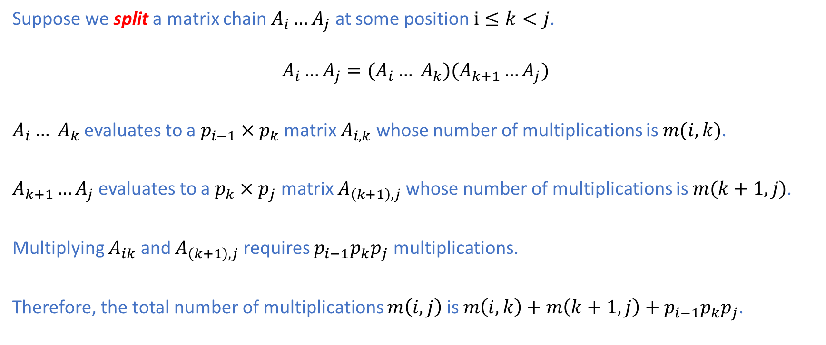
Matrix Chain Multiplication: Optimal Substructure
Suppose we split a matrix chain $A_{i}…A_{j}$ at some position $i≤k<j$.
$$A_{i}…A_{j}=(A_{i}… A_{k})(A_{k+1}…A_{j})$$
$A_{i}… A_{k}$ evaluates to a $p_{i−1}×p_{k}$ matrix $A_{i,k}$ whose number of multiplications is $m(i,k)$.
$A_{k+1}…A_{j}$ evaluates to a $p_{k}×p_{j}$ matrix $A_{\left(k+1\right),j}$whose number of multiplications is $m(k+1,j)$.
Multiplying $A_{ik}$ and $A_{\left(k+1\right),j}$ requires $p_{i−1}p_{k}p_{j}$ multiplications.
Therefore, the total number of multiplications $m\left(i,j\right)$is $m\left(i,k\right)+m\left(k+1,j\right)+p_{i−1}p_{k}p_{j}$.

Slide 20
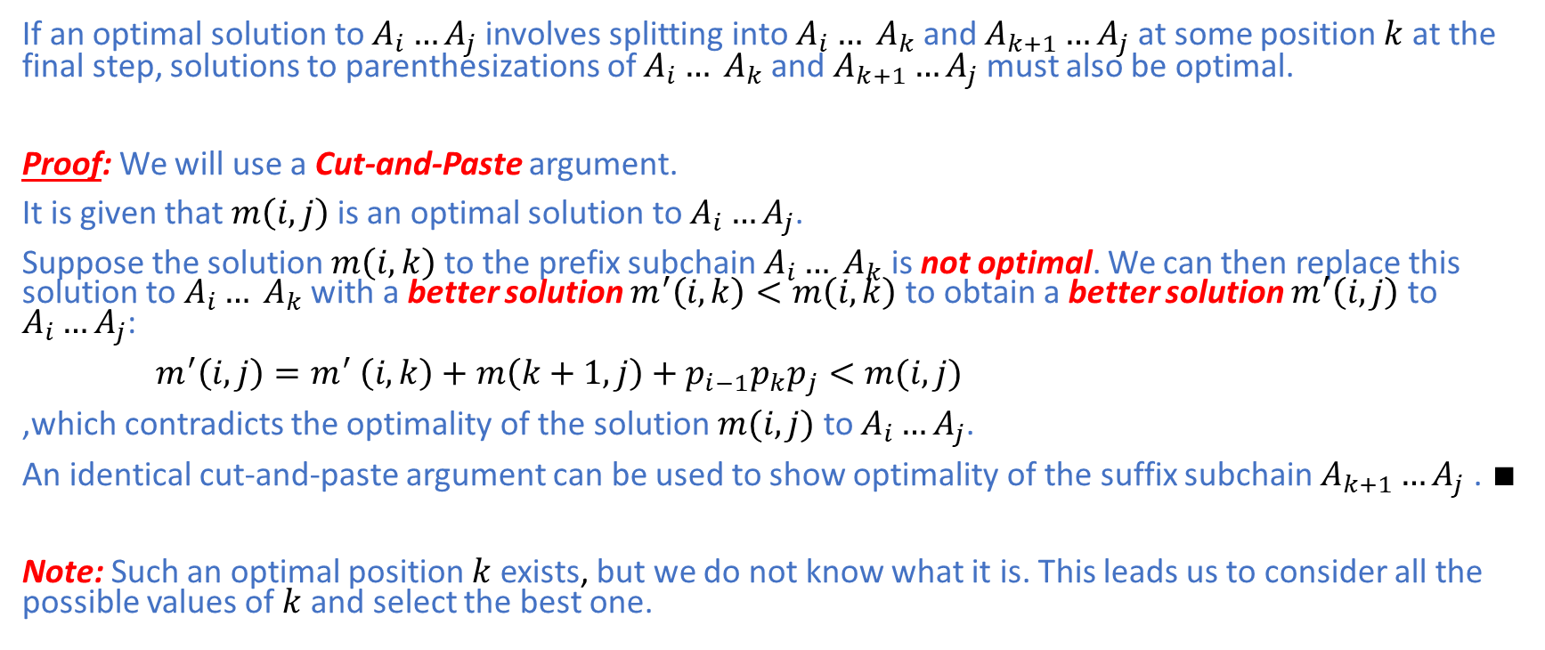
Matrix Chain Multiplication: Optimal Substructure
If an optimal solution to $A_{i}…A_{j}$ involves splitting into $A_{i}… A_{k}$ and $A_{k+1}…A_{j}$at some position $k$ at the final step, solutions to parenthesizations of $A_{i}… A_{k}$ and $A_{k+1}…A_{j}$must also be optimal.
Proof: We will use a Cut-and-Paste argument.
It is given that $m\left(i,j\right)$ is an optimal solution to $A_{i}…A_{j}$.
Suppose the solution $m\left(i,k\right)$ to the prefix subchain $A_{i}… A_{k}$ is not optimal. We can then replace this solution to $A_{i}… A_{k}$ with a better solution $m^{′}\left(i,k\right)<m\left(i,k\right)$ to obtain a better solution $m^{′}\left(i,j\right)$to $A_{i}…A_{j}$:
$m^{′}\left(i,j\right)=m^{′} \left(i,k\right)+m\left(k+1,j\right)+p_{i−1}p_{k}p_{j}<m(i,j)$
,which contradicts the optimality of the solution $m(i,j)$ to $A_{i}…A_{j}$.
An identical cut-and-paste argument can be used to show optimality of the suffix subchain $A_{k+1}…A_{j}$. $∎$
Note: Such an optimal position $k$ exists, but we do not know what it is. This leads us to consider all the possible values of $k$ and select the best one.

Slide 21
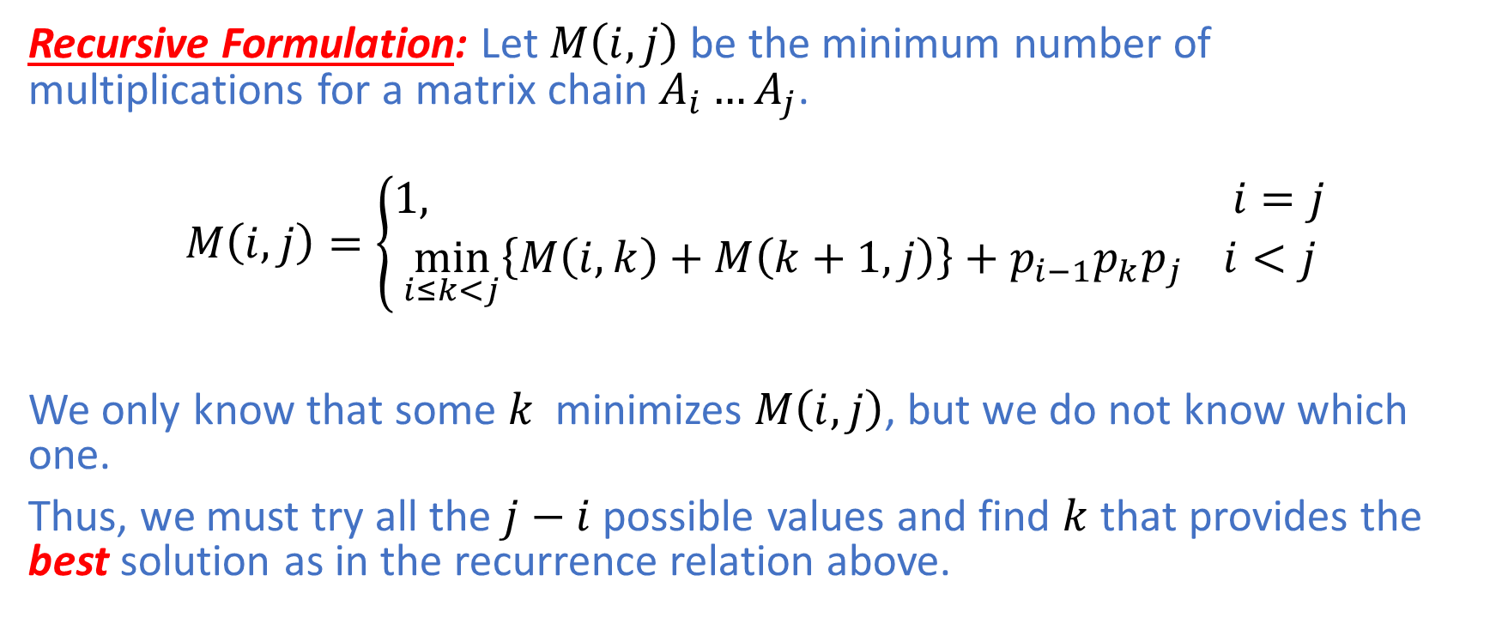
Matrix Chain Multiplication: Recursive Formulation
Recursive Formulation: Let $M\left(i,j\right)$ be the minimum number of multiplications for a matrix chain $A_{i}…A_{j}$.
$$M\left(i,j\right)=\left\{\begin{aligned}1, i=j \\ &\min_{i≤k<j}\left\{M\left(i,k\right)+M\left(k+1,j\right)\right\}+p_{i−1}p_{k}p_{j} i<j\end{aligned}\right.$$
We only know that some $k$minimizes $M\left(i,j\right)$, but we do not know which one.
Thus, we must try all the $j−i$ possible values and find $k$ that provides the best solution as in the recurrence relation above.

Slide 22
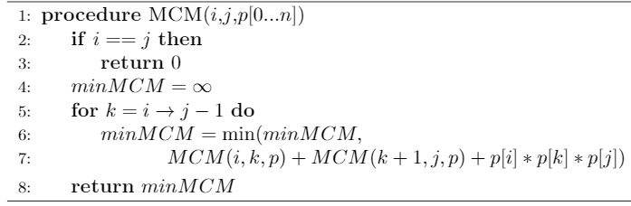
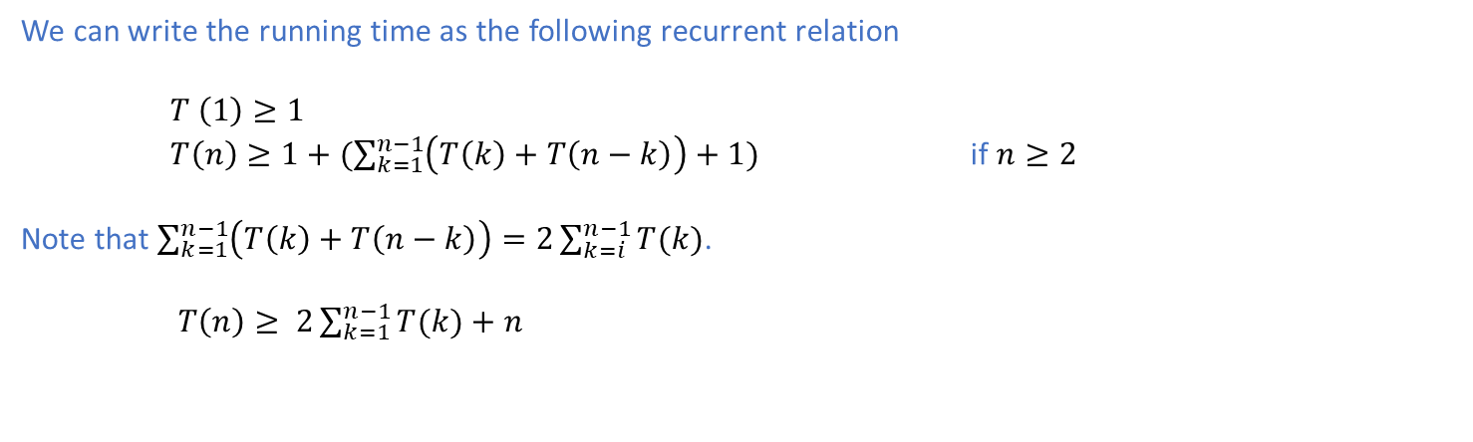
Matrix Chain Multiplication: Top-Down
We can write the running time as the following recurrent relation
$T \left(1\right)≥1$
$T\left(n\right)≥1+(\sum_{k=1}^{n−1}{\left(T\left(k\right)+T\left(n−k\right)\right)}+1)$ if $n≥2$
Note that $\sum_{k=1}^{n−1}{\left(T\left(k\right)+T\left(n−k\right)\right)=2\sum_{k=i}^{n−1}{T(k)}}$.
$T\left(n\right)≥ 2\sum_{k=1}^{n−1}{T(k)+n}$

Slide 23
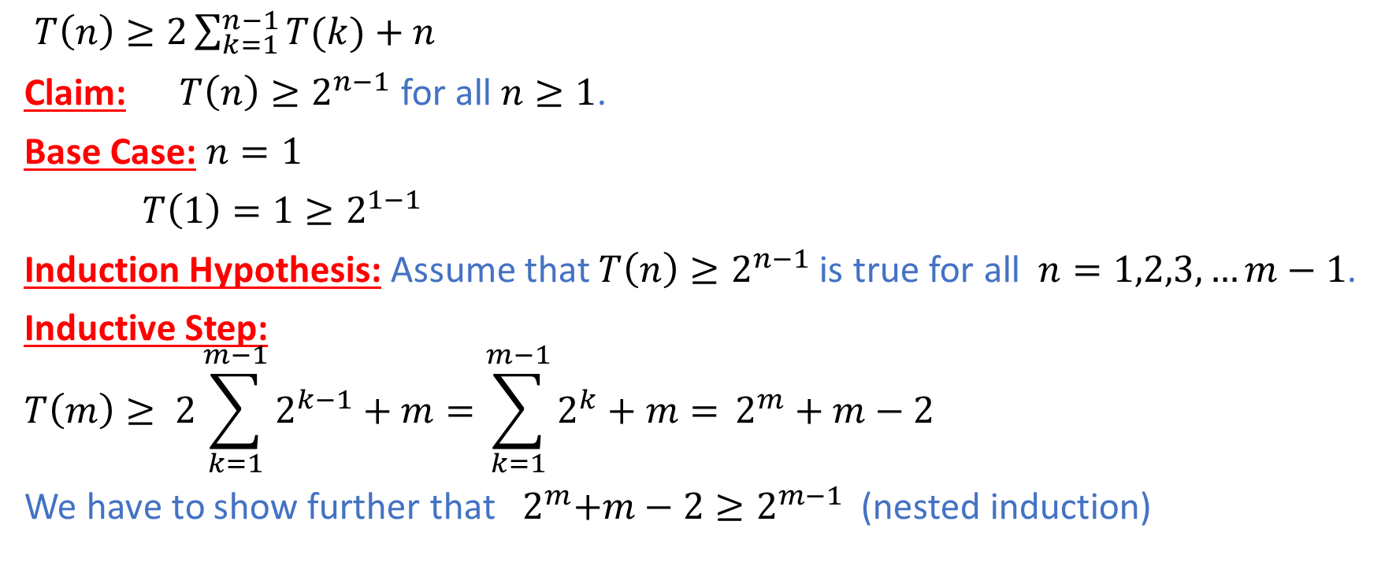
Matrix Chain Multiplication: Top-Down
$T\left(n\right)≥2\sum_{k=1}^{n−1}{T(k)+n}$
Claim: $T\left(n\right)≥2^{n−1}$ for all $n≥1$.
Base Case: $n=1$
$T\left(1\right)=1≥2^{1−1}$
Induction Hypothesis: Assume that $T\left(n\right)≥2^{n−1}$is true for all $n=1,2,3,…m−1$.
Inductive Step:
$$T\left(m\right)≥ 2\sum_{k=1}^{m−1}{2^{k−1}+m}=\sum_{k=1}^{m−1}{2^{k}+m=} 2^{m}+m−2$$
We have to show further that${ 2}^{m}+m−2≥2^{m−1}$ (nested induction)

Slide 24

Matrix Chain Multiplication: Top-Down
Claim:${ 2}^{n}+n−2≥2^{n−1}$ for all $n≥1$.
Base Case: $n=1$
${ 2}^{1}+1−2=1≥2^{1−1}$
Induction Hypothesis: Assume that ${ 2}^{k}+k−2≥2^{k−1}$for all $k≥1$.

Slide 25
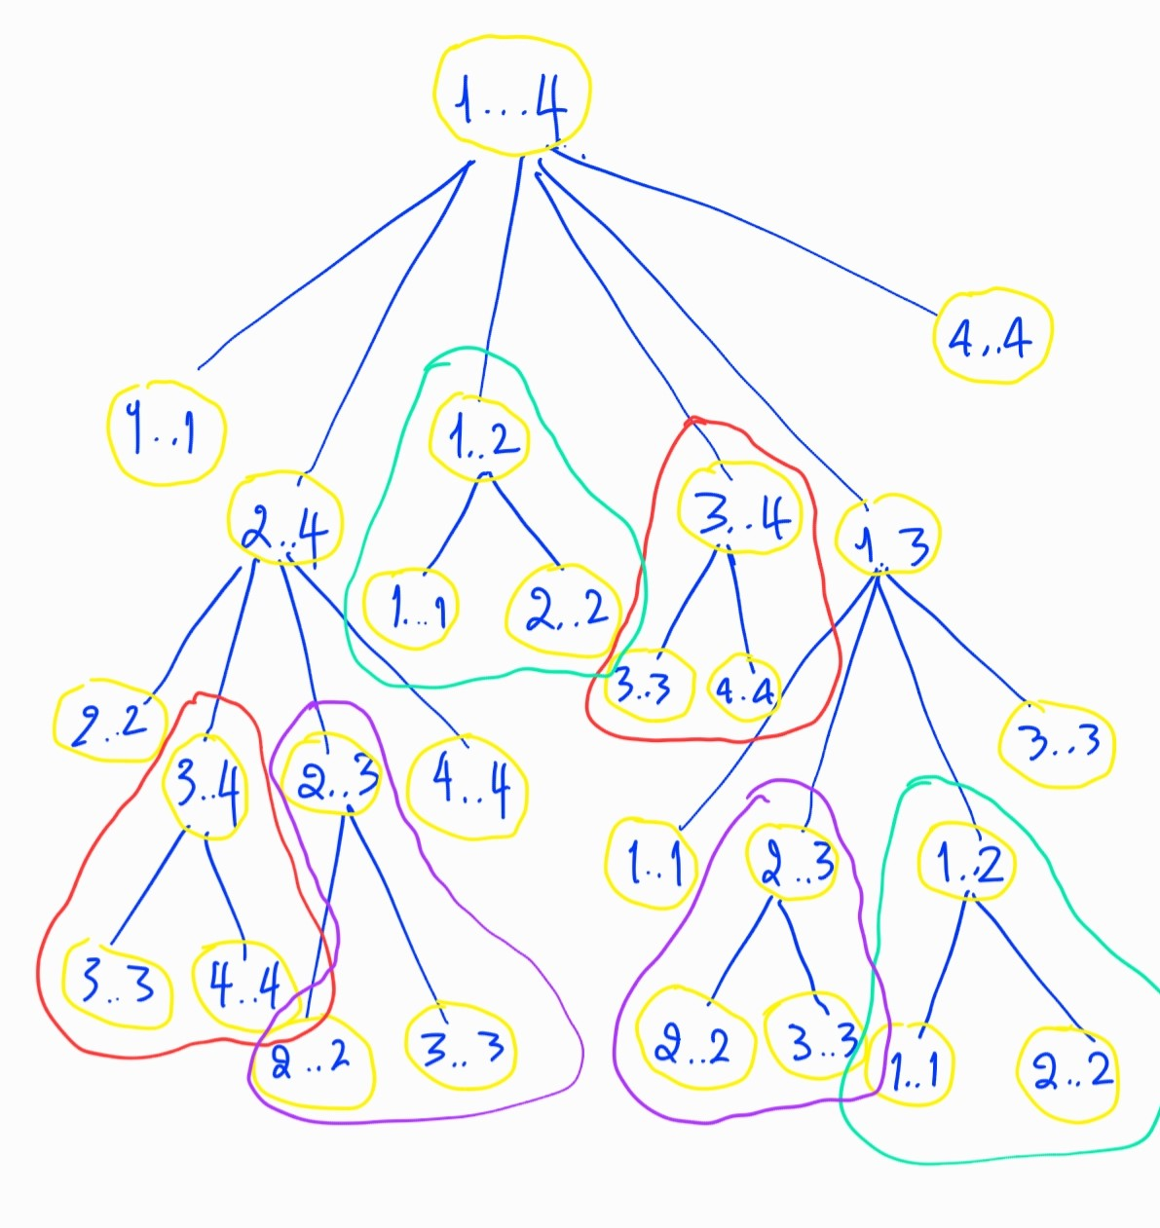
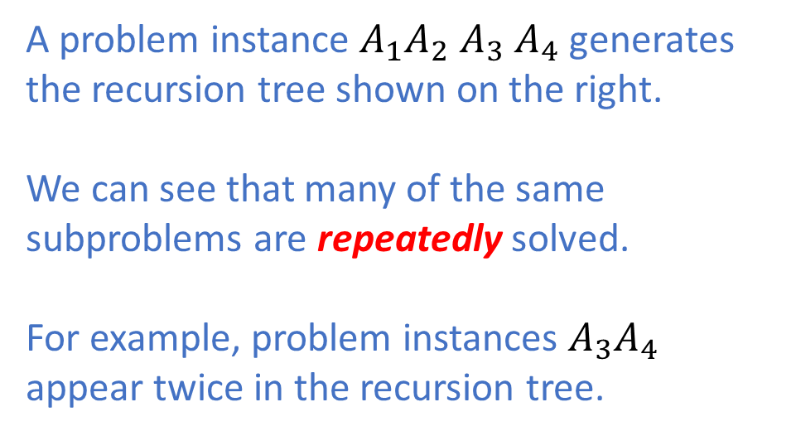
Matrix Chain Multiplication: Overlapping Subproblems
A problem instance $A_{1}A_{2}$ $A_{3}$ $A_{4}$ generates
the recursion tree shown on the right.
We can see that many of the same subproblems are repeatedly solved.
For example, problem instances $A_{3}A_{4}$ appear twice in the recursion tree.

Slide 26
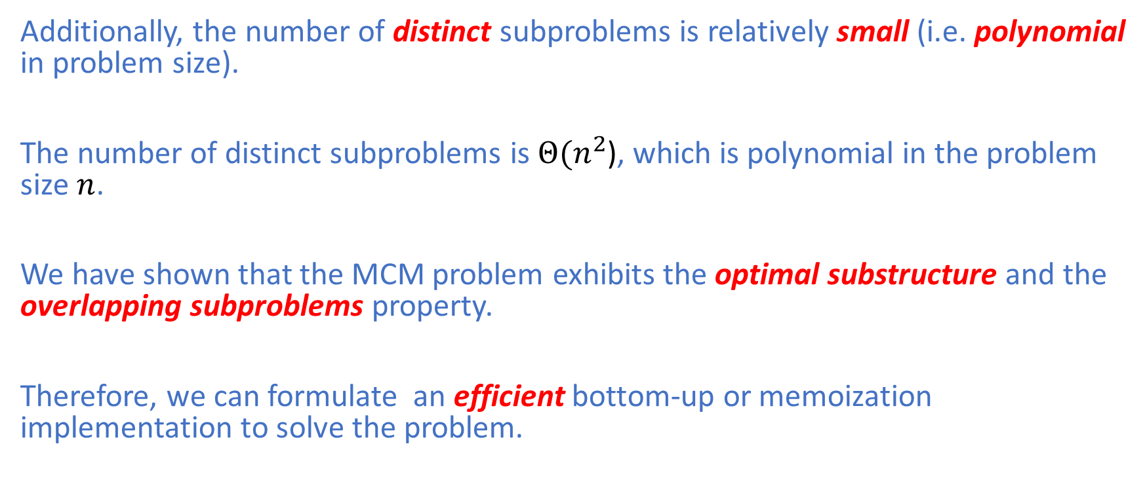
Matrix Chain Multiplication: Overlapping Subproblems
Additionally, the number of distinct subproblems is relatively small (i.e. polynomial in problem size).
The number of distinct subproblems is$Θ(n^{2}$), which is polynomial in the problem size $n$.
We have shown that the MCM problem exhibits the optimal substructure and the overlapping subproblems property.
Therefore, we can formulate an efficient bottom-up or memoization implementation to solve the problem.

Slide 27
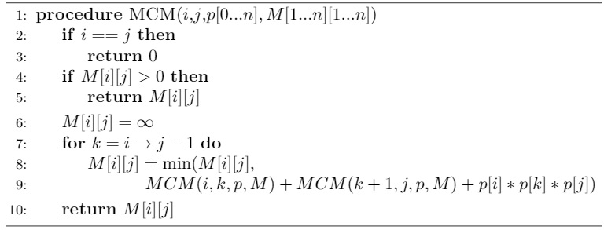
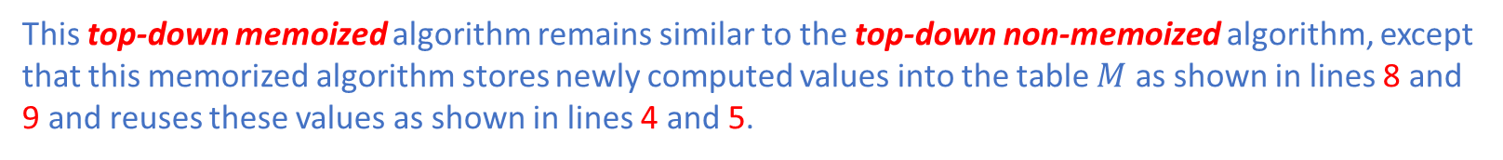
Matrix Chain Multiplication: Memoization
This top-down memoized algorithm remains similar to the top-down non-memoized algorithm, except that this memorized algorithm stores newly computed values into the table $M$ as shown in lines 8 and 9 and reuses these values as shown in lines 4 and 5.

Slide 28
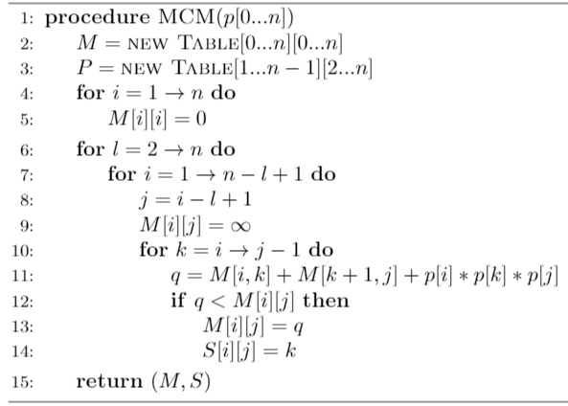
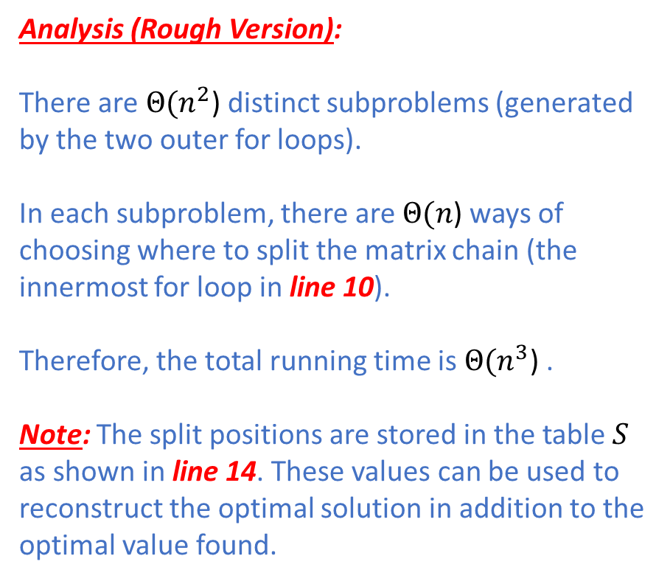
Matrix Chain Multiplication: Bottom-Up
Analysis (Rough Version):
There are $Θ(n^{2}$) distinct subproblems (generated by the two outer for loops).
In each subproblem, there are $Θ(n$) ways of choosing where to split the matrix chain (the innermost for loop in line 10).
Therefore, the total running time is $Θ(n^{3}$) . Note: The split positions are stored in the table $S$ as shown in line 14. These values can be used to reconstruct the optimal solution in addition to the optimal value found.

Slide 29
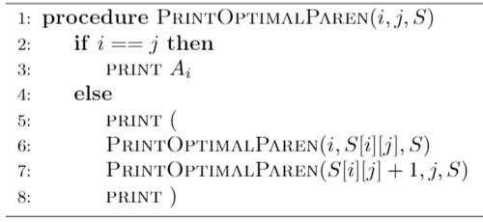
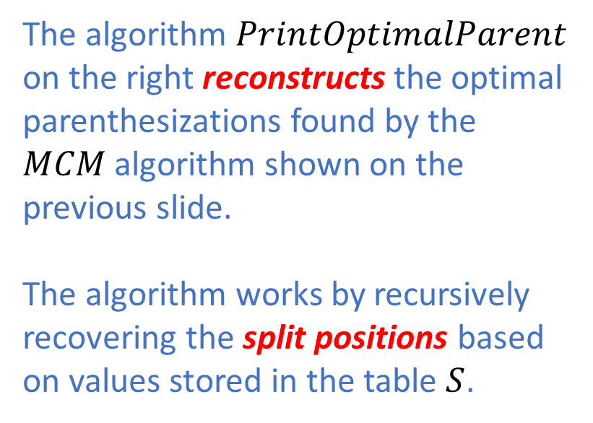
Matrix Chain Multiplication: Solution Reconstruction
The algorithm $PrintOptimalParent$ on the right reconstructs the optimal parenthesizations found by the $MCM$ algorithm shown on the previous slide.
The algorithm works by recursively recovering the split positions based on values stored in the table $S$.

Slide 30
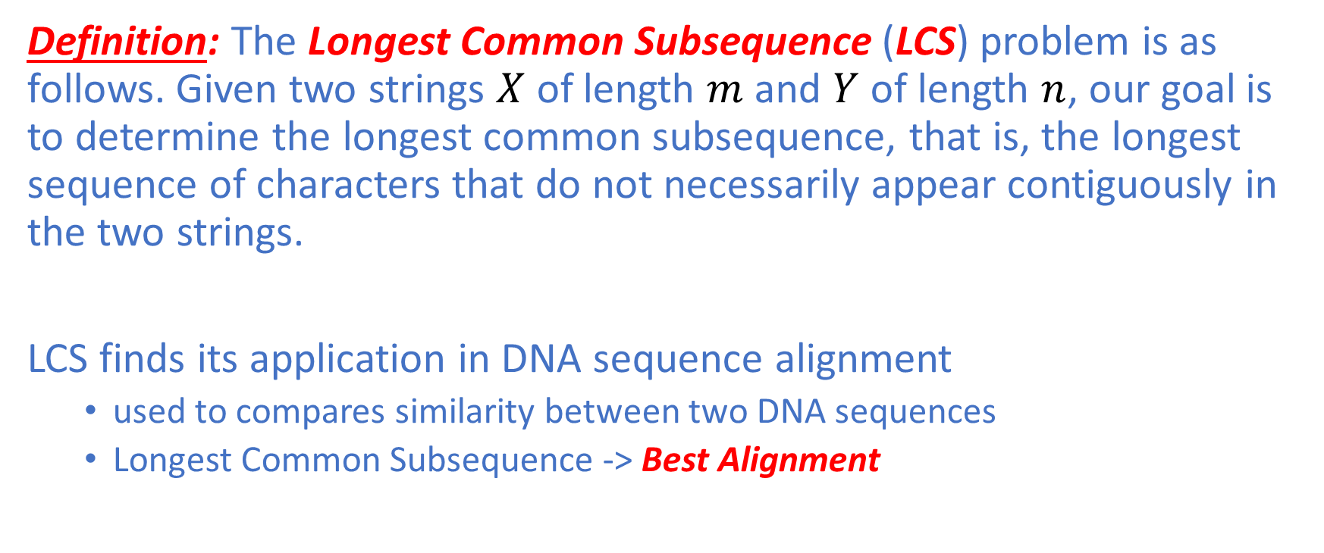
Longest Common Subsequence
Definition: The Longest Common Subsequence (LCS) problem is as follows. Given two strings $X$ of length $m$and $Y$ of length $n$, our goal is to determine the longest common subsequence, that is, the longest sequence of characters that do not necessarily appear contiguously in the two strings.
LCS finds its application in DNA sequence alignment
used to compares similarity between two DNA sequences
Longest Common Subsequence -> Best Alignment

Slide 31
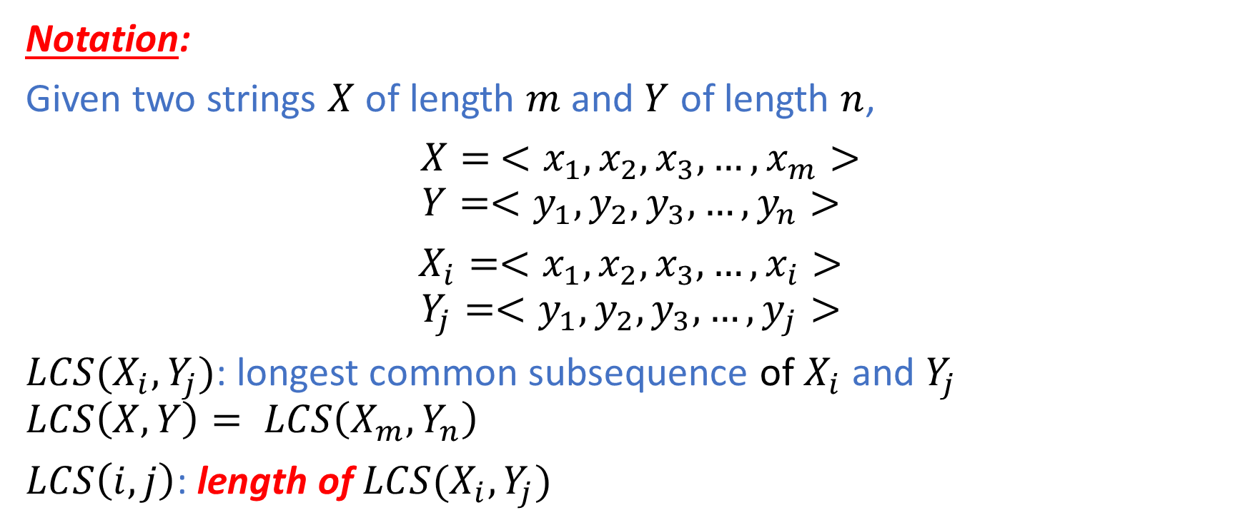
Longest Common Subsequence: Notation
Notation:
Given two strings $X$ of length $m$and $Y$ of length $n$,
$X= <x_{1},x_{2},x_{3},…,x_{m}>$
$$Y=<y_{1},y_{2},y_{3},…,y_{n}>$$
$X_{i}=<x_{1},x_{2},x_{3},…,x_{i}>$
$$Y_{j}=<y_{1},y_{2},y_{3},…,y_{j}>$$
$LCS(X_{i},Y_{j})$: longest common subsequence of $X_{i}$ and $Y_{j}$
$$LCS\left(X,Y\right)= LCS\left(X_{m},Y_{n}\right)$$
$LCS\left(i,j\right)$: length of $LCS(X_{i},Y_{j})$

Slide 32

Longest Common Subsequence: Optimal Substructure
Theorem (Optimal Substructure):
Let $X= <x_{1},x_{2},…,x_{m}>$ and $Y=<y_{1},y_{2},…,y_{n}>$ be sequences.
Let $Z=<z_{1},z_{2}, …,z_{k}>$ be any LCS of $X$ and $Y$.
1) If $x_{m}=y_{m}$, then ${z_{k}=x}_{m}=y_{m}$ and $Z_{k−1}$ is an LCS of $X_{m−1}$ and $Y_{n−1}$.
2) If $x_{m}≠y_{m}$, then ${z_{k}≠x}_{m}$ implies $Z$ is an LCS of $X_{m−1}$ and $Y_{n}$.
3) If $x_{m}≠y_{m}$, then ${z_{k}≠y}_{n}$ implies $Z$ is an LCS of $X_{m}$ and $Y_{n−1}$.

Slide 33
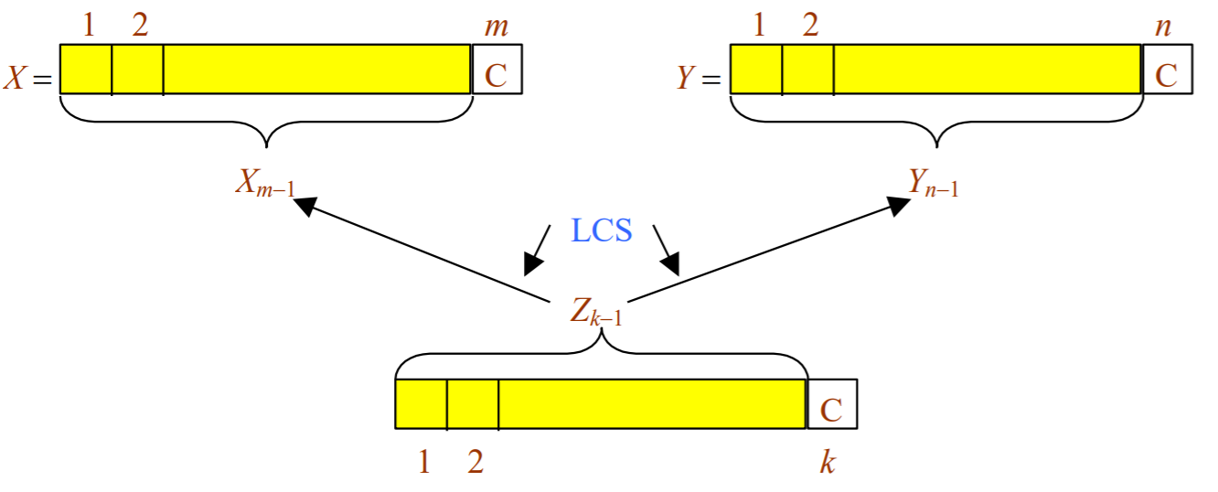
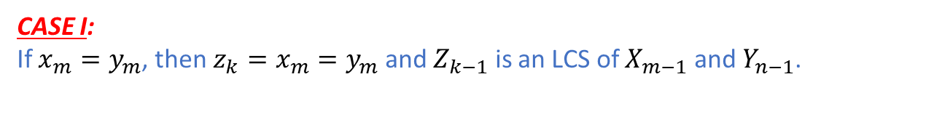
Longest Common Subsequence: Optimal Substructure
CASE I:
If $x_{m}=y_{m}$, then ${z_{k}=x}_{m}=y_{m}$ and $Z_{k−1}$ is an LCS of $X_{m−1}$ and $Y_{n−1}$.

Slide 34
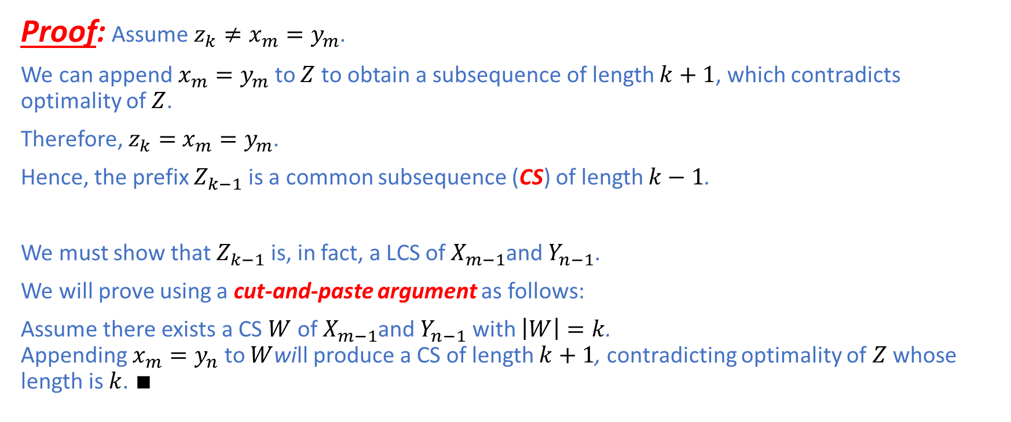
Longest Common Subsequence: Optimal Substructure
Proof: Assume ${z_{k}≠x}_{m}=y_{m}$.
We can append $x_{m}=y_{m}$ to $Z$ to obtain a subsequence of length $k+1$, which contradicts optimality of $Z$.
Therefore, $z_{k}=$ $x_{m}=y_{m}$.
Hence, the prefix $Z_{k−1}$ is a common subsequence (CS) of length $k−1$.
We must show that $Z_{k−1}$ is, in fact, a LCS of $X_{m−1}$and $Y_{n−1}$.
We will prove using a cut-and-paste argument as follows:
Assume there exists a CS $W$ of $X_{m−1}$and $Y_{n−1}$ with $\left|W\right|=k$. Appending $x_{m}=y_{n}$ to $W$will produce a CS of length $k+1$, contradicting optimality of $Z$ whose length is $k$. $∎$

Slide 35
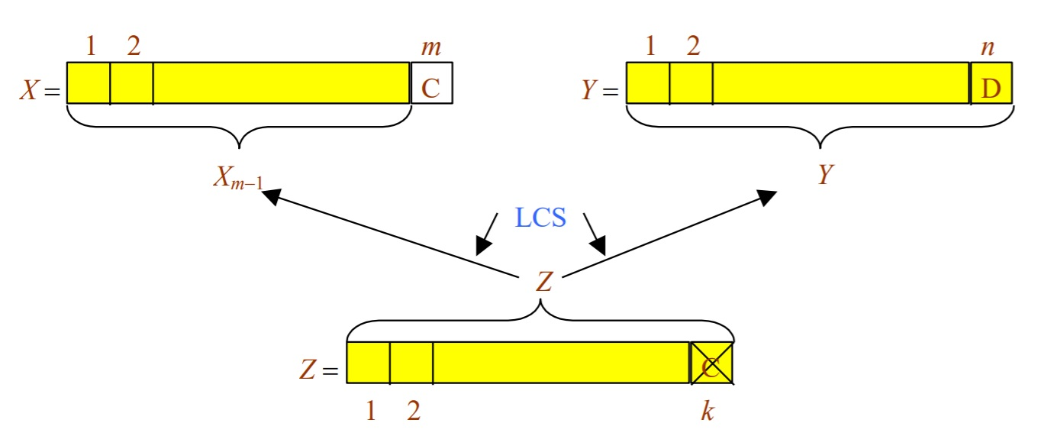

Longest Common Subsequence: Optimal Substructure
CASE II:
If $x_{m}≠y_{m}$, then ${z_{k}≠x}_{m}$ implies $Z$ is an LCS of $X_{m−1}$ and $Y_{n}$.

Slide 36
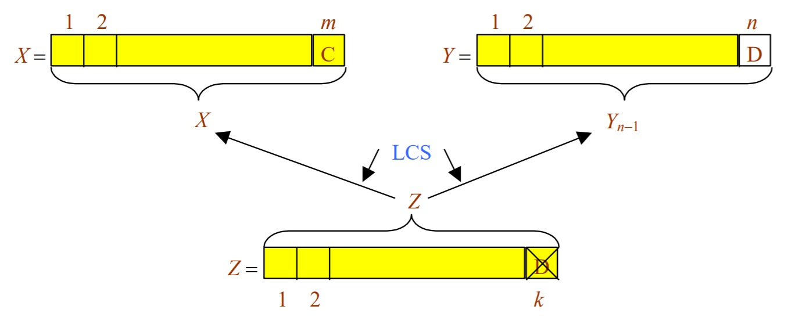

Longest Common Subsequence: Optimal Substructure
CASE III:
If $x_{m}≠y_{m}$, then ${z_{k}≠y}_{n}$ implies $Z$ is an LCS of $X_{m}$ and $Y_{n−1}$.

Slide 37
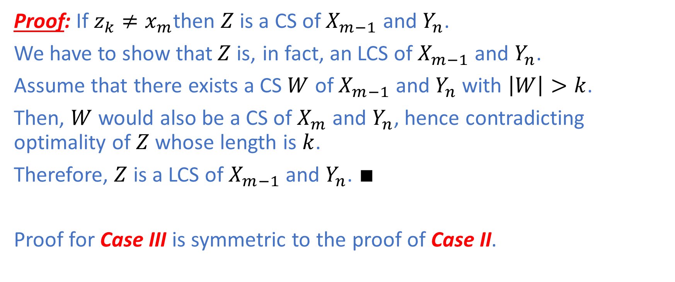
Longest Common Subsequence: Optimal Substructure
Proof: If ${z_{k}≠x}_{m}$then $Z$ is a CS of $X_{m−1}$ and $Y_{n}$.
We have to show that$Z$is, in fact, an LCS of $X_{m−1}$ and $Y_{n}$.
Assume that there exists a CS $W$ of $X_{m−1}$ and $Y_{n}$ with $\left|W\right|>k$.
Then, $W$ would also be a CS of $X_{m}$ and $Y_{n}$, hence contradicting optimality of $Z$ whose length is $k$.
Therefore, $Z$ is a LCS of $X_{m−1}$ and $Y_{n}$. $∎$
Proof for Case III is symmetric to the proof of Case II.

Slide 38

Longest Common Subsequence: Recursive Formulation
Recursive Formulation:
$$c\left[i,j\right]= \left\{\begin{aligned}0 if i=0 or j=0 \\ c \left[i−1,j−1\right]+1 if i,j>0 and x_{i}=y_{j} \\ \max\left\{c\left[i,j−1\right],c\left[i−1,j\right]\right\}if i,j>0 and x_{i}≠y_{j}\end{aligned}\right.$$

Slide 39
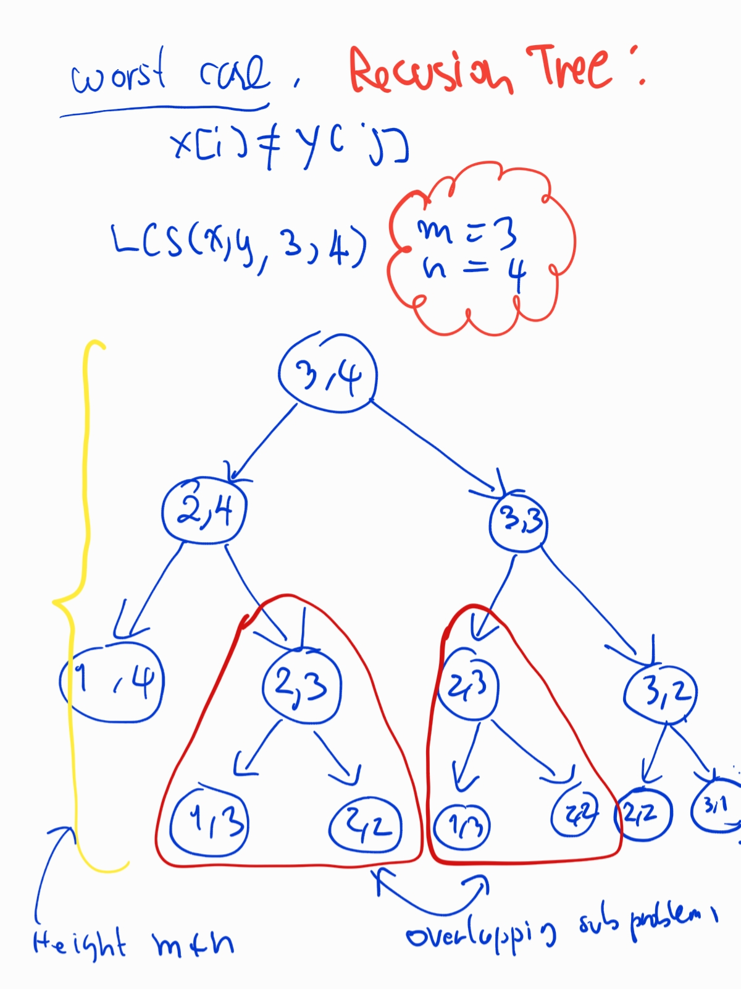
Longest Common Subsequence: Overlapping Subproblems

Slide 40
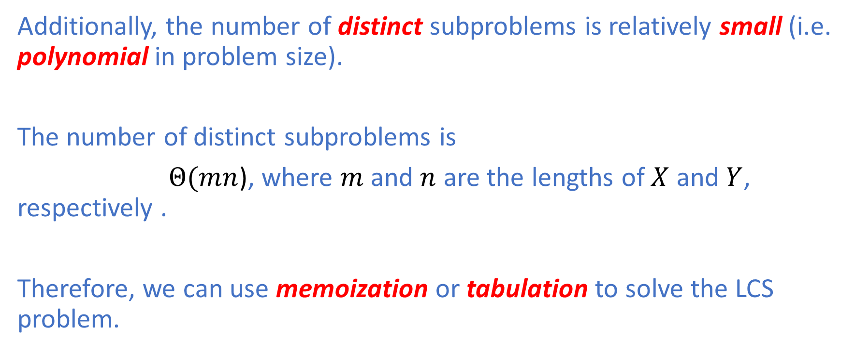
Longest Common Subsequence: Overlapping Subproblems
Additionally, the number of distinct subproblems is relatively small (i.e. polynomial in problem size).
The number of distinct subproblems is
$Θ(mn$), where $m$ and $n$ are the lengths of $X$ and $Y$, respectively .
Therefore, we can use memoization or tabulation to solve the LCS problem.

Slide 41
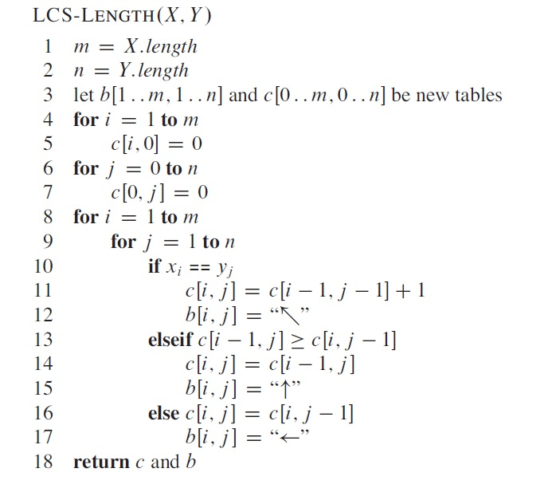
Longest Common Subsequence: Bottom-Up

Slide 42


Longest Common Subsequence: Solution Reconstruction

Slide 43
Summary
We have covered the topic of Dynamic Programming using
Fibonacci numbers
Matrix Chain Multiplication (MCM)
Longest Common Subsequence (LCS)
as examples.
Central to DP, are optimal substructure and overlapping subproblem properties. We will cover Greedy Algorithms next week.

